Slide 1
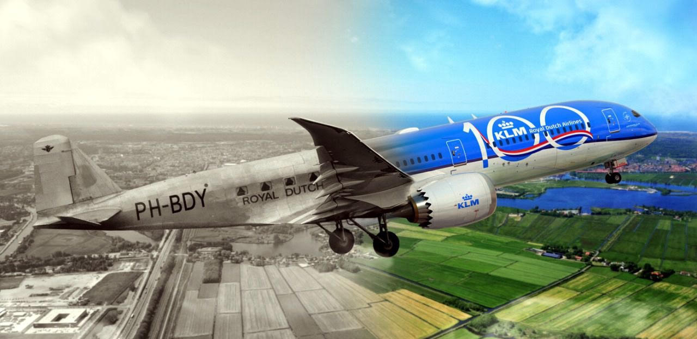
PRELIMINARY PROPULSION SIZING 1
AESP 415 – Aircraft Design Part I Basics
Lecture 9
MODULE
3
TOPIC 7
Dr. Wout De Backer
1000 Catawba St, Ste 120
wdbacker@cec.sc.edu

Slide 2
Are you on track for this course?
Have you generated concepts for your requirements?
Have you worked on your CAD models (generating/annotating technical drawings)?
Have you completed the “inside-out” cross-section fuselage design process?
Have you started writing assignment 1 (Due soon)!
Notes:
https://www.youtube.com/watch?v=AF55oyAJDBk

Slide 3
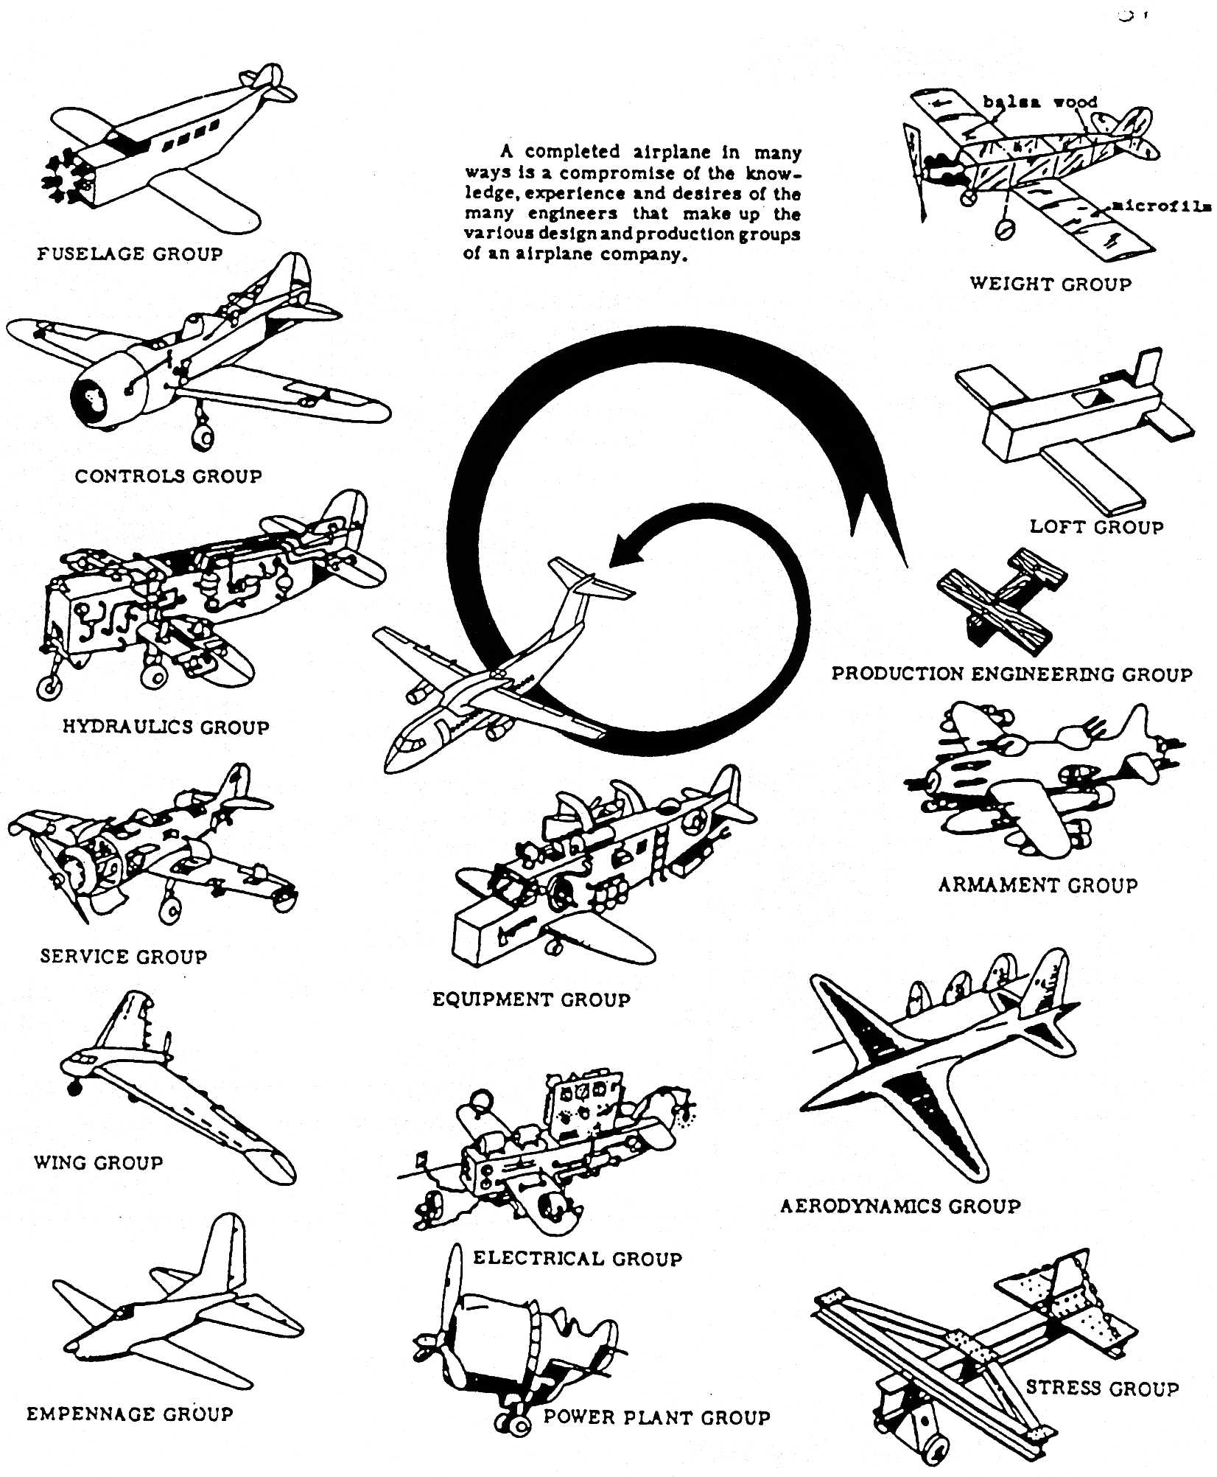
Lecture Contents
Preliminary Propulsion Sizing
7.1. Introduction
7.2. Gas Generators
7.3. Gas Turbine Thermodynamics (Recap)
7.3.1 Ideal Cycle
7.3.2 Gas Power & Efficiency
7.3.3 Real Processes
7.4. Gas Turbine Classifications & Configurations
7.5. Governing Equations of Gas Turbines
7.6. Engine Scaling techniques
7.6.1 Piston Engine Scaling
7.6.2 Propeller Engine Scaling
7.6.3 Turbojet Engine Scaling
7.6.4 Effects of Altitude and Velocity
7.7. Engine Manufacturers & Joint Programs
7.8. Future Developments
Notes:
Contents from this slide deck is sourced and adapted from Aircraft Design 1 Course. Content by Dr. Arvind. G. Rao and prof J.P. van Buijtenen from Delft, University of Technology

Slide 4
7.1 Introduction
Balloon Analogy:
Imagine a balloon

Slide 5
7.1 Introduction
Balloon Analogy:
Escaping air acceleration Cs
Reaction balloon acceleration Co
Releasing air creates a propulsive reaction
Notes:
Pressure in and out
An Area through which the air escapes.
Note mdot is flow rate (kg/s) and c_s = stream/escape velocity and c_0 is reaction velocity (m/s)

Slide 6
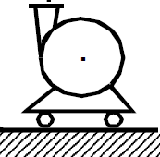
7.1 Introduction
Balloon Analogy:
Escaping air acceleration Cs
Reaction balloon acceleration Co
Adding external air supply creates endurance
Notes:
Now imagine we magically attach a compressor to it and add air as it escapes

Slide 7
7.1 Introduction
Balloon Analogy:
Escaping air acceleration Cs
motor
Reaction balloon acceleration Co
Electricity
Combining the supply with the balloon
Notes:
Put the compressor in front

Slide 8
7.1 Introduction
Balloon Analogy:
Escaping air acceleration Cs
Reaction balloon acceleration Co
Fuel
Fuel driven turbine system within the balloon
Notes:
Make it a fuel-based compressor

Slide 9
7.1 Introduction
Balloon Analogy:
Escaping air acceleration Cs
Reaction balloon acceleration Co
Fuel
Increasing mass flow increases acceleration
Notes:
Turbofan, bypass

Slide 10
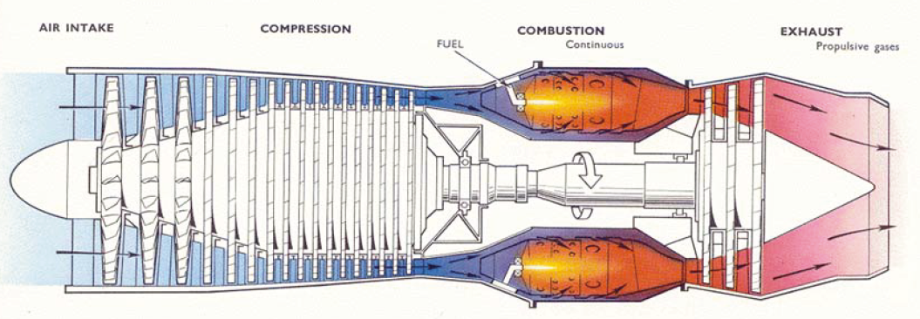
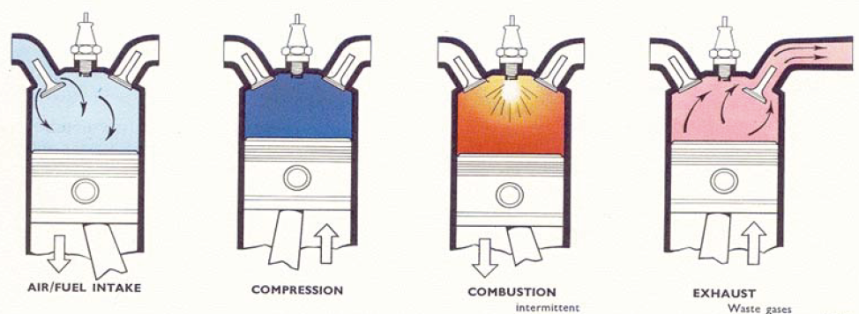
7.1 Introduction
A pure jet engine:
Equivalent piston cycles:
Notes:
Suck squeeze bang blow

Slide 11
7.1 Introduction
A pure jet engine:

Slide 12
7.1 Introduction
Components of a propulsion system:
Energy carrier
Power generator
Thrust generator
Type | Power Range | Speed Range (Mach) | Power to Weight (KW/kg) | Efficiency (%)
Military Aircraft Engine | < 15 MW | Up to Mach 2 | 10 | 25
Large Turbofans | < 50 MW | < Mach 1 | 5 | 35
Micro Gas Turbines | < 5 KW | < Mach 1 | 2 | 7
Turbo Props | < 10 MW | < Mach 0.7 | 5 | 35
Electric Motors | < 100 KW | < Mach 0.7 | 3 | 90
Internal Combustion Engines | < 500 KW | < Mach 0.7 | 0.6 | 30
Wankel engines | < 100 KW | < Mach 0.7 | 2.5 | 20
Fuel Type | Energy density | Pollution
Kerosene | 43 MJ/Kg | High
Hydrogen | 120 MJ/kg | Moderate
Electric (Batteries, e.g. Lithium Ion) | 2 KJ/kg | Low
Fuel Cells | 3 KJ/kg | Low
Energy carrier
Power generators

Slide 13
7.1 Introduction
NiCAD battery
50-75 Wh/kg
Propulsion system & energy storage types
Fuel cell
39 kWh/kg
Piston engine
600W/kg
Electric motor
3 KW/kg
Gas turbine
5 KW/kg
Li-Ion battery 260-270 Wh/kg
Kerosene
?? kWh/kg
Notes:
What is the energy density of kerosene? 12 kWh/kg for kerosene

Slide 14
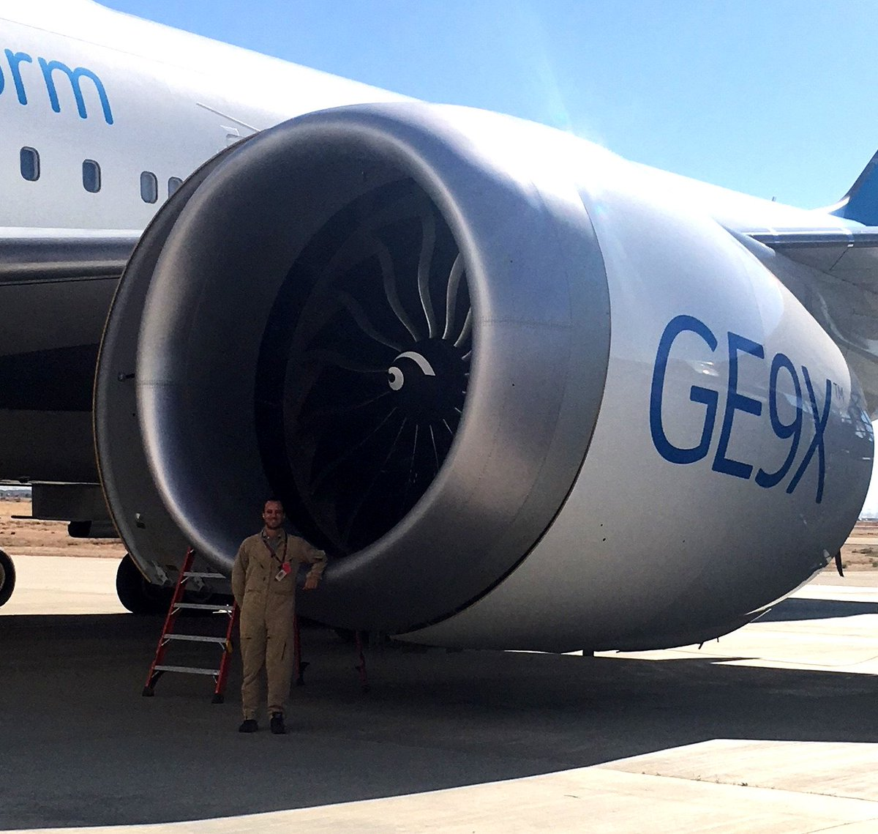
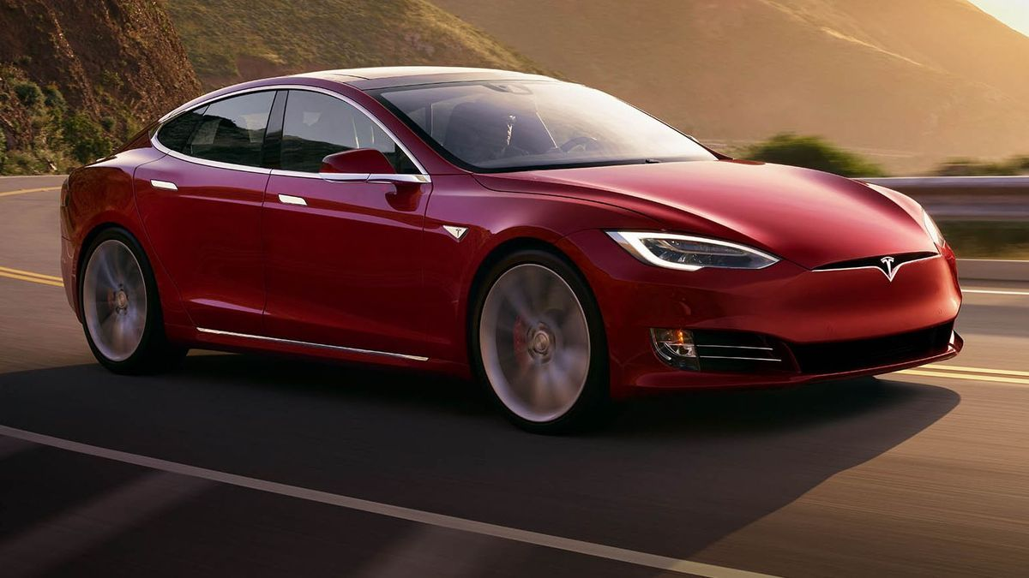
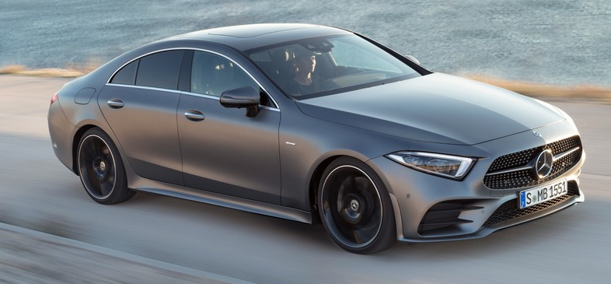
7.1 Introduction
Why a gas turbine?
1 GE 9X engine has the power of 91 Tesla Model S (sports)cars
Mercedes-Benz CLS-class
270 KW (362 HP)
Tesla Model S
515 KW
GE 9X (B777)
47000 KW per engine
Notes:
Who here drives an SUV? Takes a cruise?

Slide 15
7.1 Introduction
Fuel (in gallons) per passenger carry a passenger for 350 miles:
Notes:
Time in hrs

Slide 16
7.1 Introduction

Slide 17
Lecture Contents
Preliminary Propulsion Sizing
7.1. Introduction
7.2. Gas Generators
7.3. Gas Turbine Thermodynamics (Recap)
7.3.1 Ideal Cycle
7.3.2 Gas Power & Efficiency
7.3.3 Real Processes
7.4. Gas Turbine Classifications & Configurations
7.5. Governing Equations of Gas Turbines
7.6. Engine Scaling techniques
7.6.1 Piston Engine Scaling
7.6.2 Propeller Engine Scaling
7.6.3 Turbojet Engine Scaling
7.6.4 Effects of Altitude and Velocity
7.7. Engine Manufacturers & Joint Programs
7.8. Future Developments
Notes:
Contents from this slide deck is sourced and adapted from Aircraft Design 1 Course. Content by Dr. Arvind. G. Rao and prof J.P. van Buijtenen from Delft, University of Technology

Slide 18
7.2 Gas Generators
A gas generator generates power in the form of hot pressurized gas (gas power)
Generating Gas Power
Conversion of available energy in fuel to gas power (Gas generator)
Generating Thrust Power
Conversion of gas power into propelling jet, increase momentum of the gas flow) (Propeller, Jet, Rotor)

Slide 19
7.2 Gas Generators
A gas generator generates power in the form of hot pressurized gas (gas power)
Gas power
Shaft power
Kinetic power
Indirect
Direct
Generators
Pumps
Rotors
Propellers
Bypass engines
Turbofans
Turbojets

Slide 20
Lecture Contents
Preliminary Propulsion Sizing
7.1. Introduction
7.2. Gas Generators
7.3. Gas Turbine Thermodynamics (Recap)
7.3.1 Ideal Cycle
7.3.2 Gas Power & Efficiency
7.3.3 Real Processes
7.4. Gas Turbine Classifications & Configurations
7.5. Governing Equations of Gas Turbines
7.6. Engine Scaling techniques
7.6.1 Piston Engine Scaling
7.6.2 Propeller Engine Scaling
7.6.3 Turbojet Engine Scaling
7.6.4 Effects of Altitude and Velocity
7.7. Engine Manufacturers & Joint Programs
7.8. Future Developments
Notes:
Contents from this slide deck is sourced and adapted from Aircraft Design 1 Course. Content by Dr. Arvind. G. Rao and prof J.P. van Buijtenen from Delft, University of Technology

Slide 21
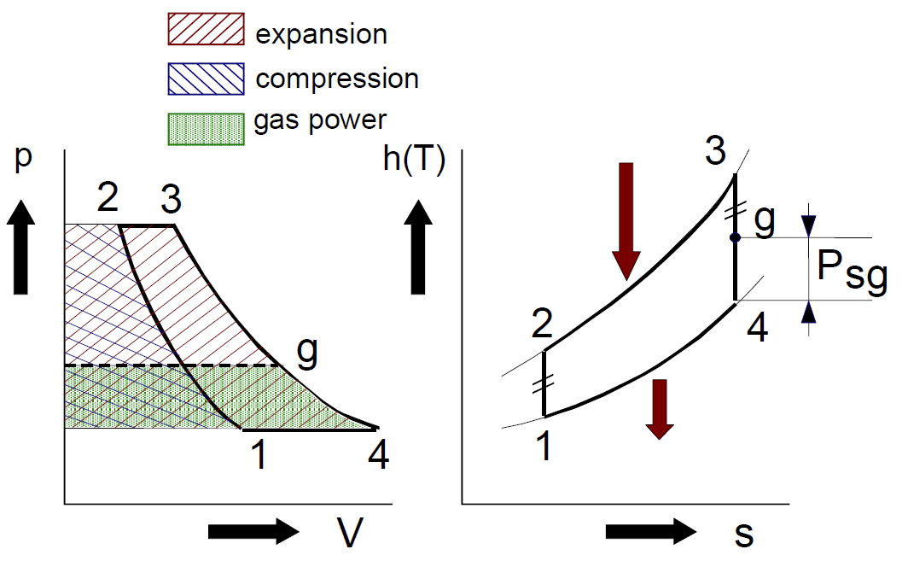
7.3 Gas Turbine Thermodynamics (Recap)
From your propulsion class:
Notes:
1-2 compression, energy is the shaded area
2-3 boom
3-4 out
h enthalpy is a function of temperature H = E + PV.
According to the law of energy conservation, the change in internal energy is equal to the heat transferred to, less the work done by, the system
S = entropy
V volume
p pressure

Slide 22
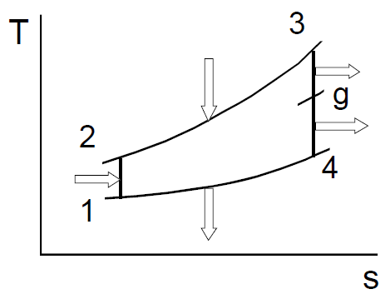
7.3.1 Ideal Cycle
Assumptions for the ideal cycle:
Ideal gas with constant c_{p} and c_{v} and constant composition
Constant mass flow
Compression and expansion is adiabatic and reversible (i.e. isentropic)
No pressure losses
No energy loss per component
1st law of thermodynamics:
With Q = input heat
W = Output power
m = mass
T = temperature [K]
S = entropy
Notes:
1 -> 2 is vertical

Slide 23
7.3.1 Ideal Cycle
1st law of thermodynamics:
Leads to:
Compression stage
Heat supply stage
Expansion 1 stage
Expansion 2 (Gas generator power)
Heat Discharge stage
Notes:
Work done, providing work
Providing heat

Slide 24
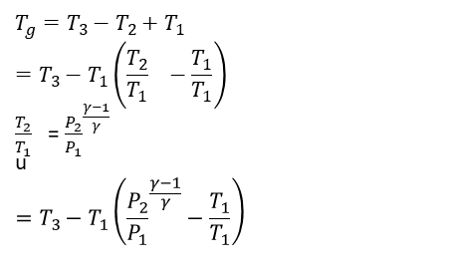
7.3.1 Ideal Cycle
$$T_{g}=T_{3}−T_{2}+T_{1}$$
$$=T_{3}−T_{1}\left({\frac{T_{2}}{T_{1}}}^{}−\frac{T_{1}}{T_{1}}\right)$$
${\frac{T_{2}}{T_{1}}}^{}$= ${\frac{P_{2}}{P_{1}}}^{\frac{γ−1}{γ}}$
u
$$=T_{3}−T_{1}\left({\frac{P_{2}}{P_{1}}}^{\frac{γ−1}{γ}}−\frac{T_{1}}{T_{1}}\right)$$
Power balance in an ideal cycle:
And if we set that:
We get that:
Now, assuming mass flow and c_{p} are equal:
Solve for Tg
Notes:
Gamma = Cp/CV (ratio of specific heats for the gas)
T_g=T_3 - T_2 + T_1
=T_3-T_1 ((T_2/T_1 ) - T_1 / T_1 )
=T_3-T_1 ((P_2/P_1 )^((γ-1)/γ) - T_1/T_1 ) (where the relation for adiabatic compression was used T_2/T_1= (P_2/P_1 )^((γ-1)/γ) )

Slide 25
7.3.2 Gas power & Efficiency
Rearranging:
Then, from the ideal gas law:
Rearranging
Substitution

Slide 26
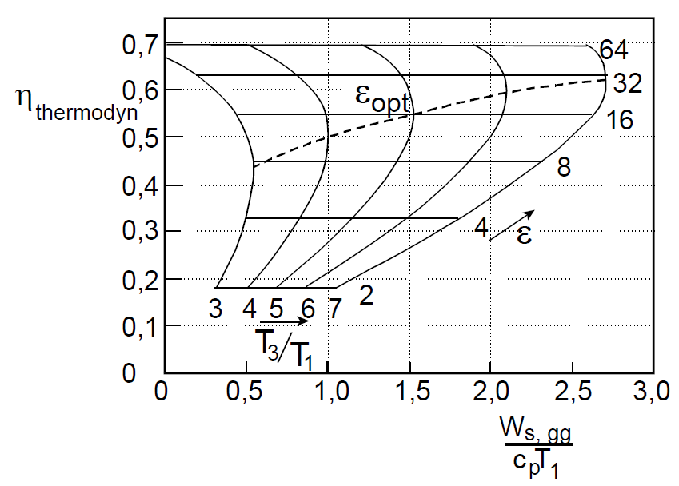
7.3.2 Gas power & Efficiency
Specific Power can be defined as:
With thermodynamic efficiency defined as:

Slide 27
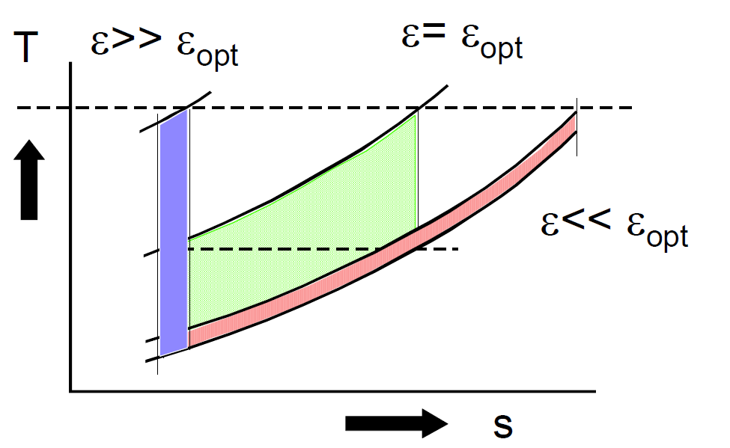
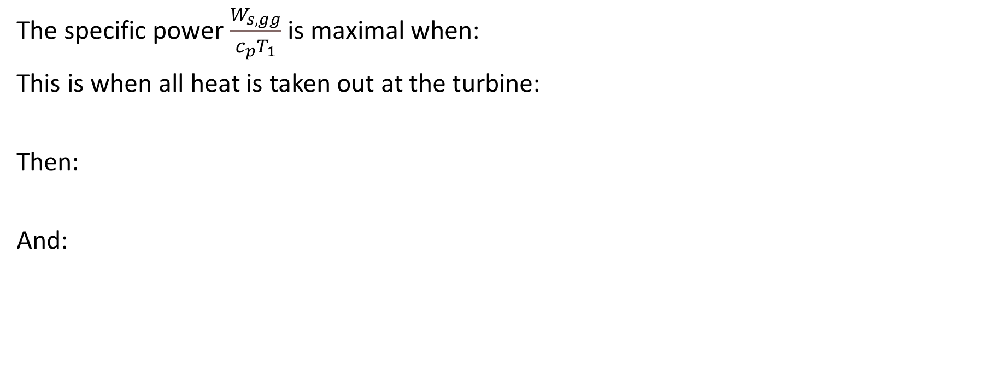
7.3.2 Gas Power & Efficiency
The specific power $\frac{W_{s,gg}}{c_{p}T_{1}}$ is maximal when:
This is when all heat is taken out at the turbine:
Then:
And:
Note that:
Notes:
Maximize the area, the green area is maximized

Slide 28
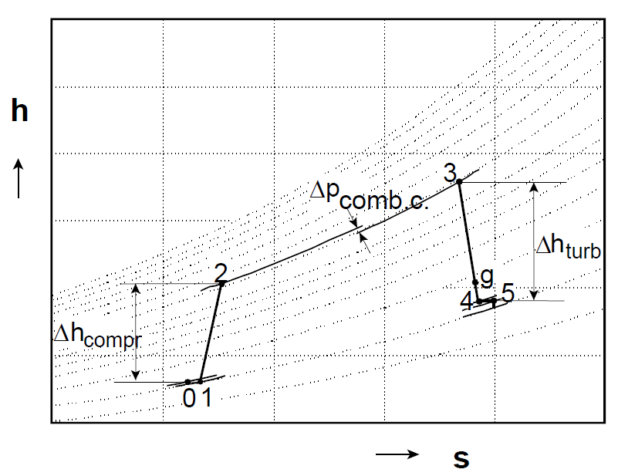
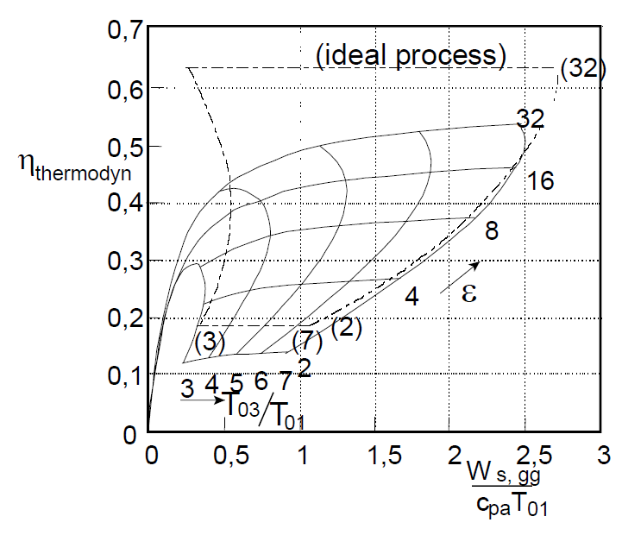
7.3.3 Real Processes
In real processes there will be losses (non-isentropic):
Notes:
Non-ideal vs ideal

Slide 29
Lecture Contents
Preliminary Propulsion Sizing
7.1. Introduction
7.2. Gas Generators
7.3. Gas Turbine Thermodynamics (Recap)
7.3.1 Ideal Cycle
7.3.2 Gas Power & Efficiency
7.3.3 Real Processes
7.4. Gas Turbine Classifications & Configurations
7.5. Governing Equations of Gas Turbines
7.6. Engine Scaling techniques
7.6.1 Piston Engine Scaling
7.6.2 Propeller Engine Scaling
7.6.3 Turbojet Engine Scaling
7.6.4 Effects of Altitude and Velocity
7.7. Engine Manufacturers & Joint Programs
7.8. Future Developments
Notes:
Contents from this slide deck is sourced and adapted from Aircraft Design 1 Course. Content by Dr. Arvind. G. Rao and prof J.P. van Buijtenen from Delft, University of Technology

Slide 30
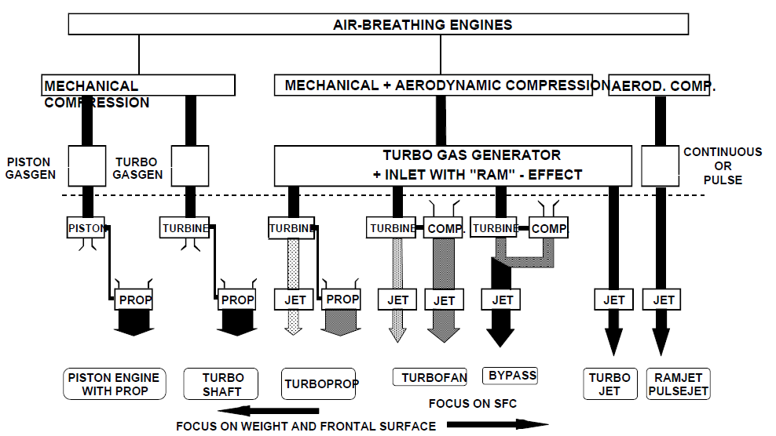
7.4 Gas Turbine Classifications & Configurations
Typical Engine Configurations:
Turbojet
All air passes through combustion chamber
Turbofan
Bypass ratio
Mixed vs. separate exhaust nozzles
Turboprop
Propeller + (limited amount of) exhaust jet thrust)
Free vs. fixed power turbine (single vs. twin shaft)
Single vs. multiple shaft engines
Notes:
Efficiency vs speed.
Ram effect in turboprop/fan/bypass

Slide 31
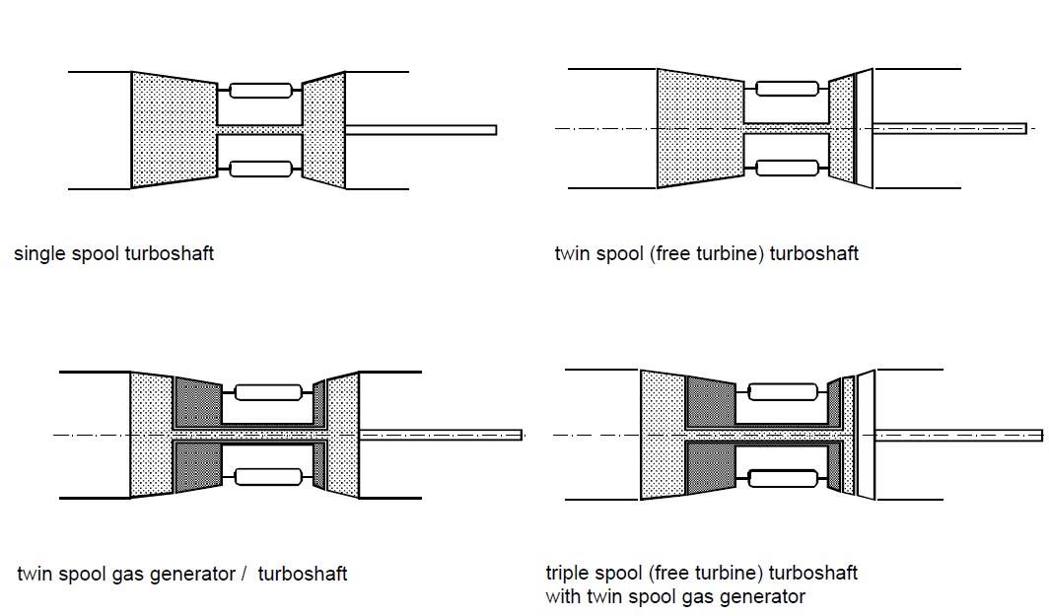
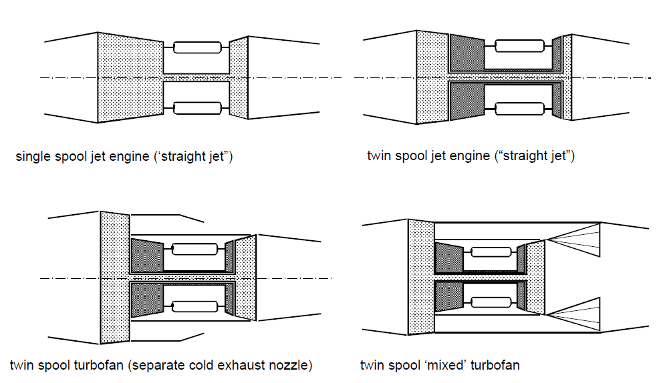
7.4 Gas Turbine Classifications & Configurations
Typical Engine Classifications:
Turboshaft (-prop) Engine Configurations
Jet Engine Configurations
Notes:
Turboshaft, primarily compression and acceleration in the prop. Energy comes from the turbine

Slide 32
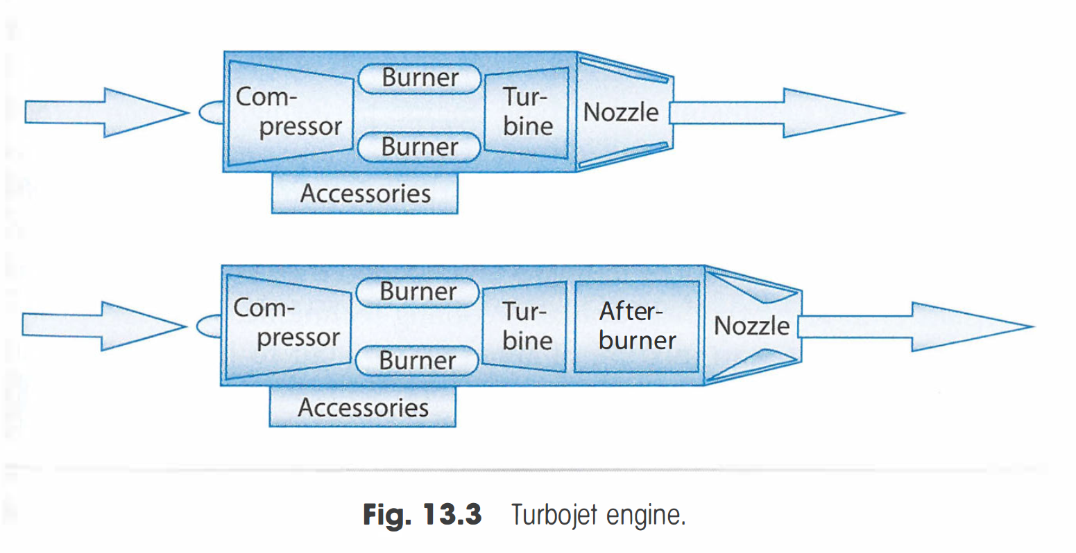
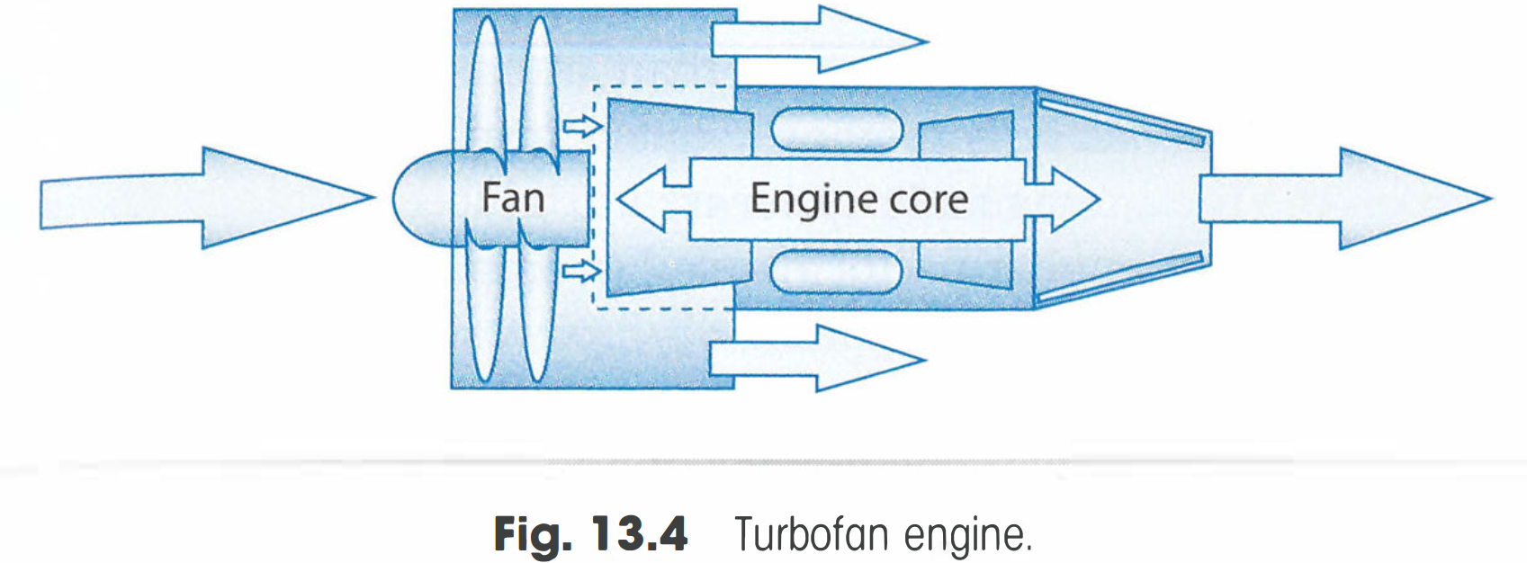
7.4 Gas Turbine Classifications & Configurations
Typical Engine Classifications:

Slide 33
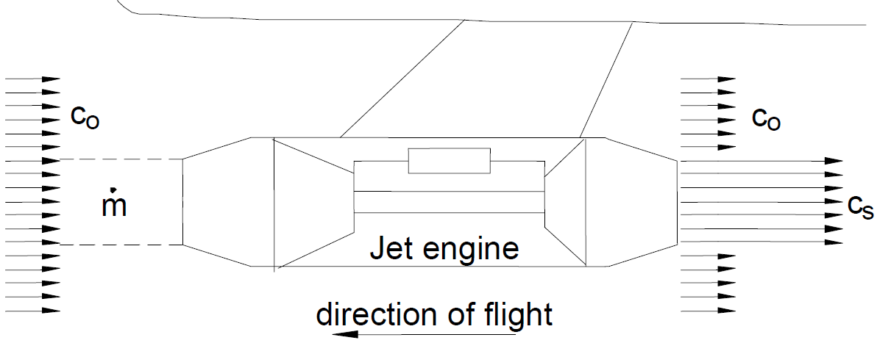
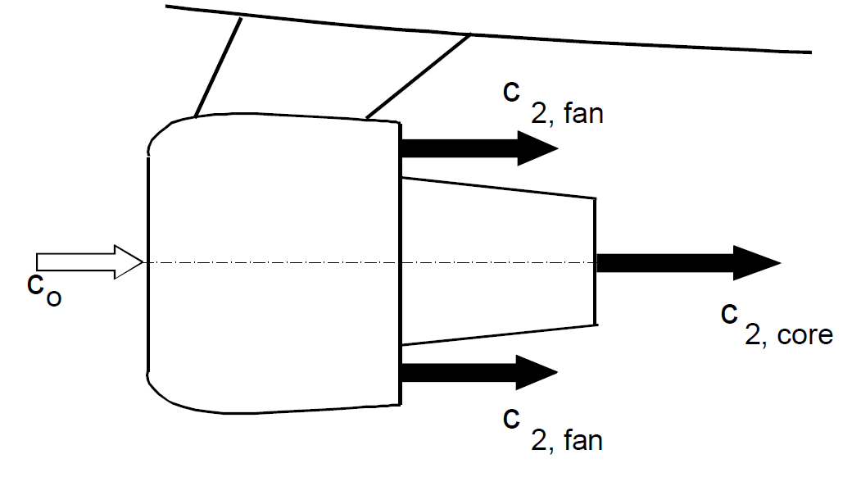
7.4 Gas Turbine Classifications & Configurations
Typical Engine Classifications:
Pure jet engine
Jet Engine with core bypass

Slide 34
7.4 Gas Turbine Classifications & Configurations
Main engine stations:
Intake
Compressor (axial/radial)
Combustor (annular, can type)
Turbine (axial/radial)
Afterburner/reheat
Nozzle & Exhaust

Slide 35
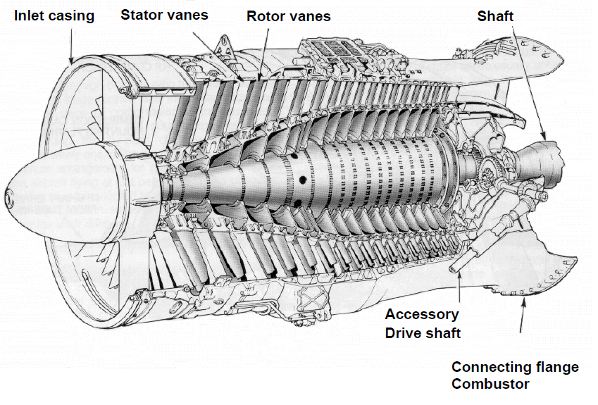
7.4 Gas Turbine Classifications & Configurations
Engine Components: Compressor (axial/radial)
Radial compressor
Axial compressor
Notes:
Don’t require a flow reversal in an axial compressor
Stator vanes drop velocity, clean flow and increase pressure

Slide 36
7.4 Gas Turbine Classifications & Configurations
Engine Components: Combustor
Typical requirements for the combustor are:
Must provide high combustion efficiency over wide operating conditions
Low pressure loss over the combustion system
Stable combustion over wide range of inlet conditions and mass flow
Reliable starting/relight capability
Minimum size/length/weight
Low cost and good durability, maintainability, reliability
Long operating life/long engine life
Stable combustor exit temperature/flow pattern (for longer engine life)
Multi-fuel capability (flexibility)
Notes:
Highly compressed flow enters the combustor
Operating conditions: Flow during take-off/landing/cruise/climb
Jet A1, ethanol
Discuss picture, flow. Part of the flow is cooling. Left to right

Slide 37
7.4 Gas Turbine Classifications & Configurations
Engine Components: Combustor
The combustor has liners to actively cool itself
Combustor Zones:
Primary zone
Anchors the flame
Provides sufficient time, temperature and turbulence for mixing
Secondary Zone
Used to stabilize and complete combustion reaction processes
General air flow pattern

Slide 38
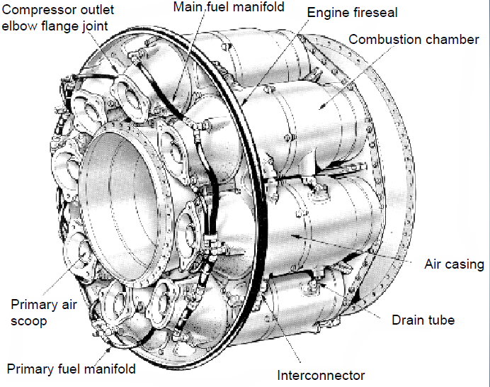
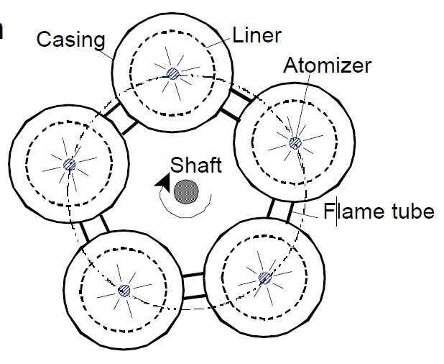
7.4 Gas Turbine Classifications & Configurations
Engine Components: Can-type Combustor
Oldest form
Simple development
Strong
Easy maintenance/assembly
Notes:
Can and annular, can is isolated combustion types

Slide 39
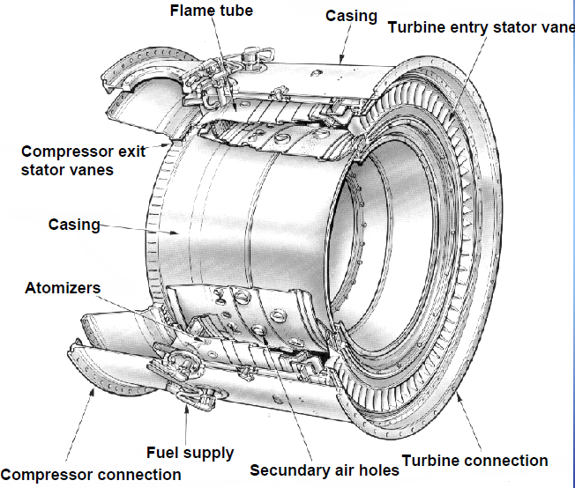
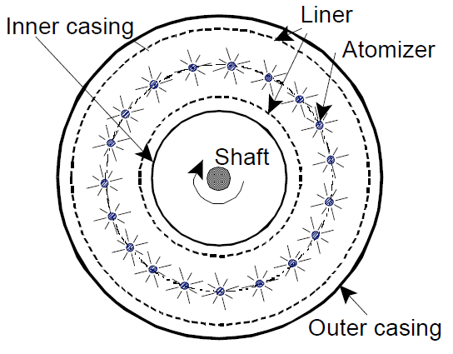
7.4 Gas Turbine Classifications & Configurations
Engine Components: Annular Combustor
Compact
Good temperature distribution
Notes:
“automatic relight”
Losing a can would upset the symmetry, causing vibrational issues

Slide 40
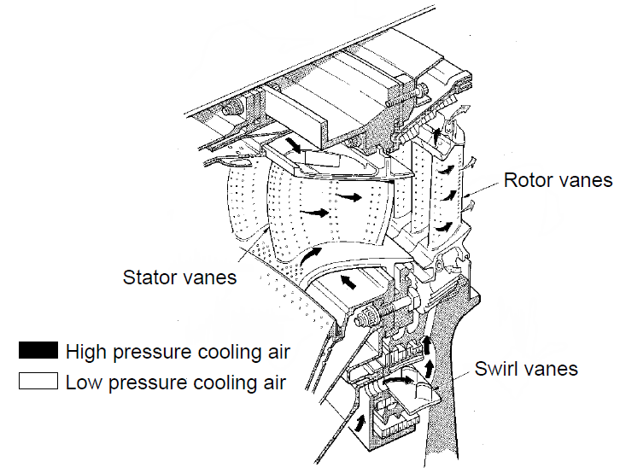
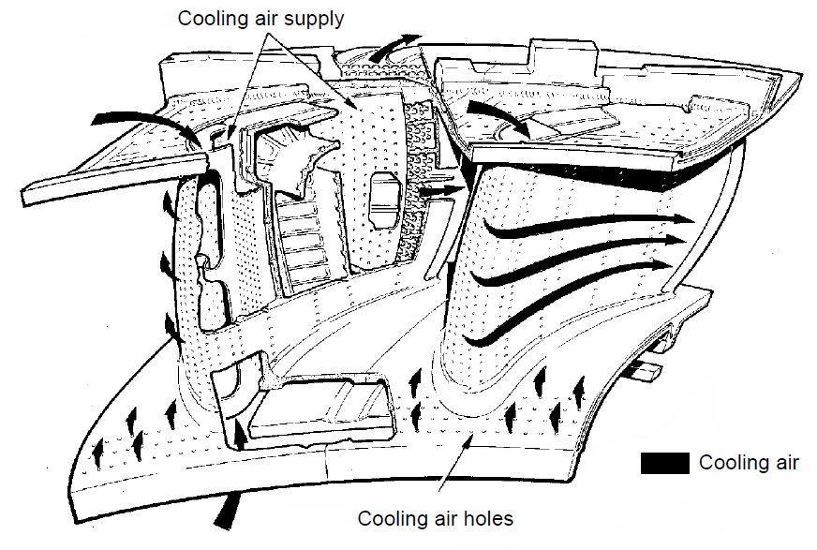
7.4 Gas Turbine Classifications & Configurations
Engine Components: Turbine
Turbine blades are actively cooled, and are very complex parts
Notes:
Minimum power out of the flow to keep the engine running,

Slide 41
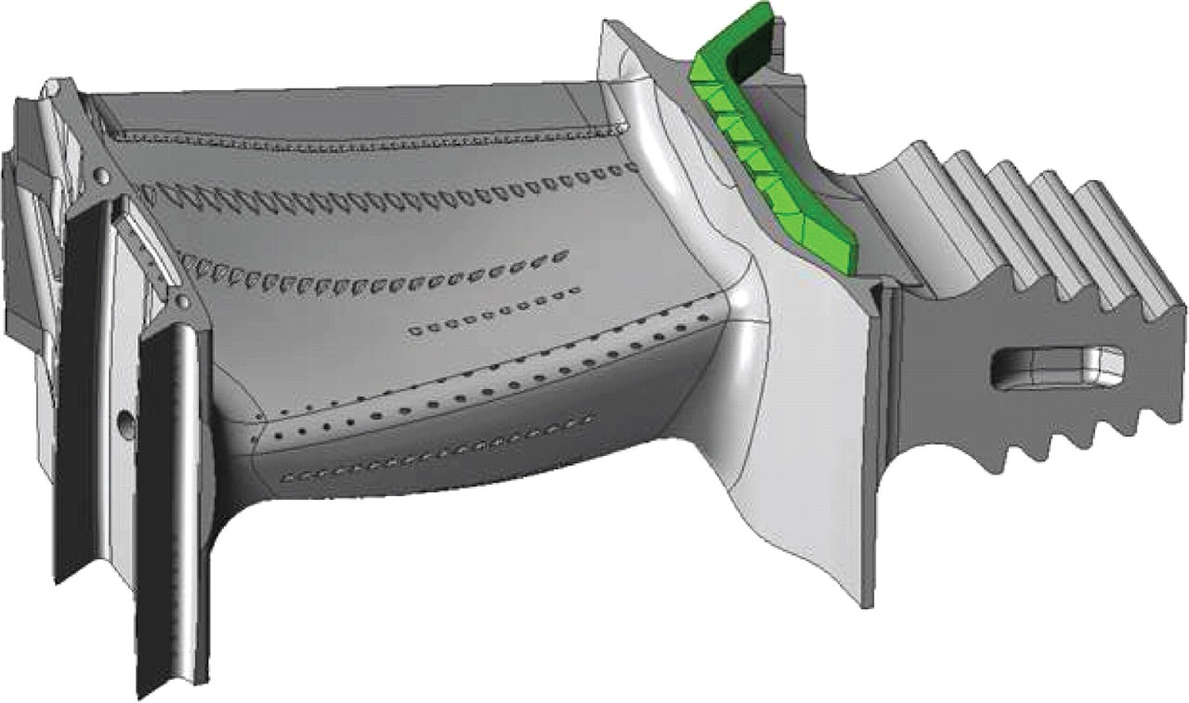
7.4 Gas Turbine Classifications & Configurations
Engine Components: Turbine
Notes:
3d printing, channels and complexity, (lost wax casting and cnc machining)

Slide 42
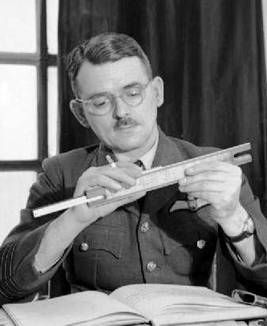
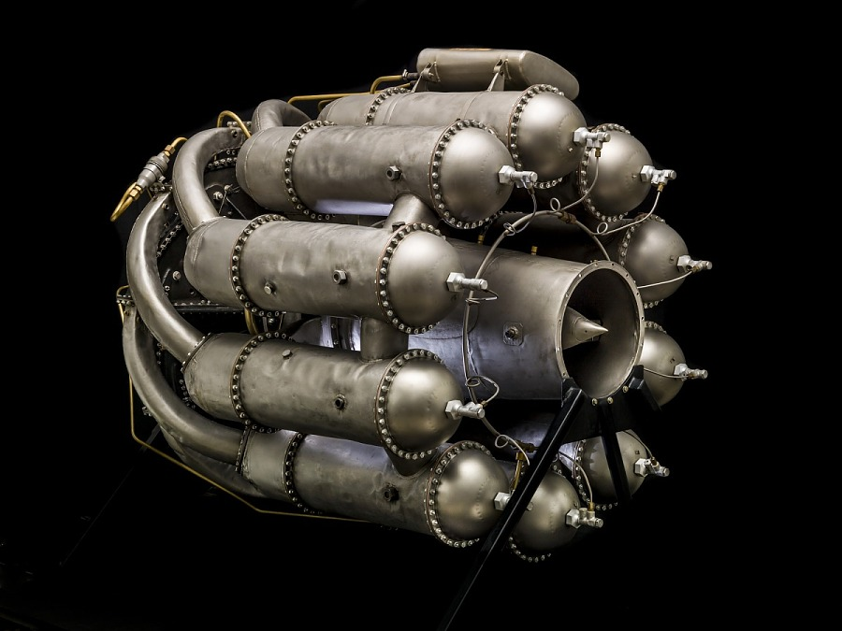
7.4 Gas Turbine Classifications & Configurations
Early Jet Engines: Frank Whittle, inventor of the turbojet engine
Whittle’s patent (1932)
Whittle’s can-type combustor
Whittle GlosterE28 configuration
Notes:
Rotary compression and turbine, flow has lots of bends

Slide 43
7.4 Gas Turbine Classifications & Configurations
Turbojet Engines:
Single spool turbojet with axial compressor

Slide 44
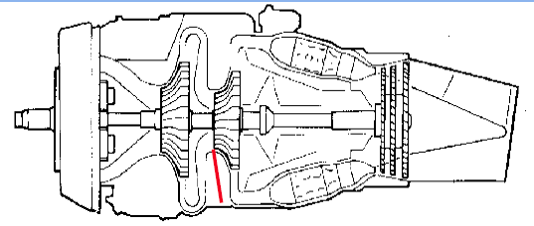
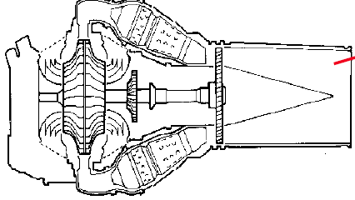
7.4 Gas Turbine Classifications & Configurations
Example turboprops:

Slide 45
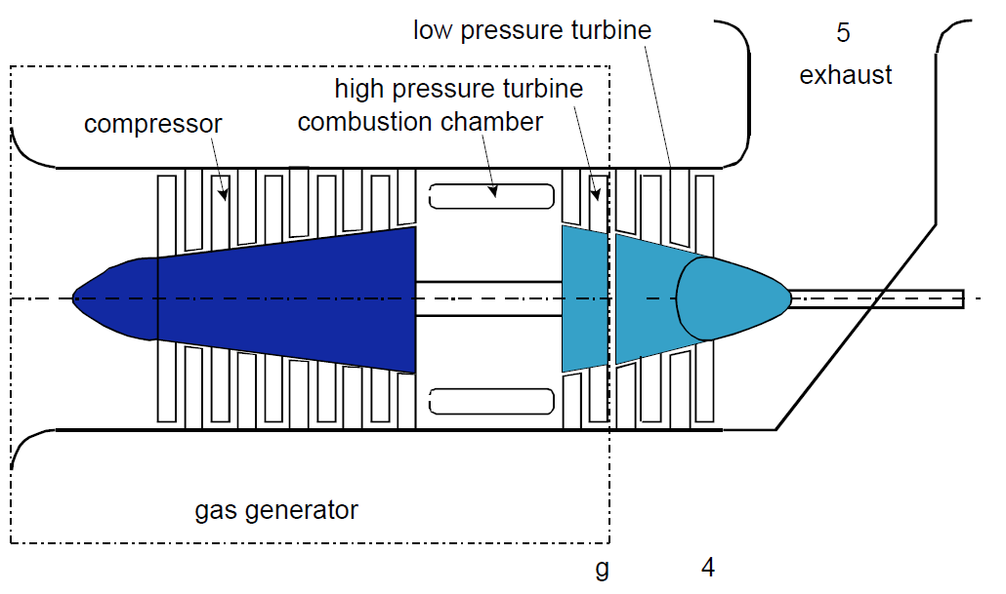
7.4 Gas Turbine Classifications & Configurations
Examples: Helicopter Turboshaft

Slide 46
7.4 Gas Turbine Classifications & Configurations
Turbofan Engines:
Notes:
Much more efficient, relative velocity (see propulsion class)

Slide 47
7.4 Gas Turbine Classifications & Configurations
Military Turbofan Engines with afterburner:
F100-PW-220 (F-15 / F-16)
F119-F22, F-135 - JSF
Notes:
Isotropic line moves up, very inefficient
Vector nozzle

Slide 48
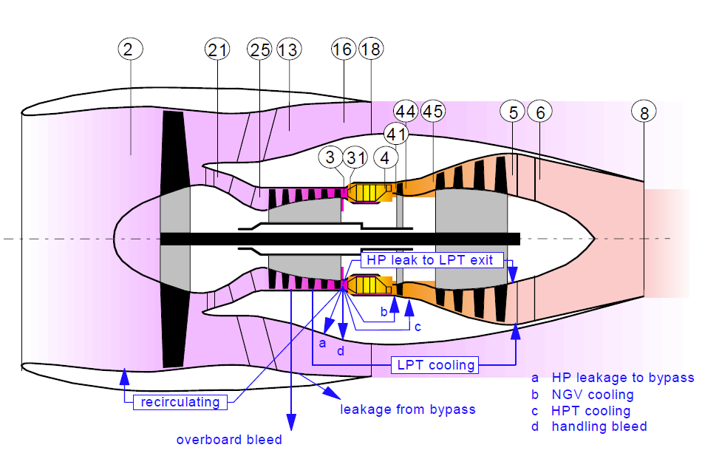
7.4 Gas Turbine Classifications & Configurations
High-bypass turbofan Engines: Stations
Notes:
Example high-bypass turbofan. Transonic is to be avoided by slowing down flow and ram effect
Geared down turbofan slowing down the front blade allowing more energy to go in without breaking the sound barrier

Slide 49
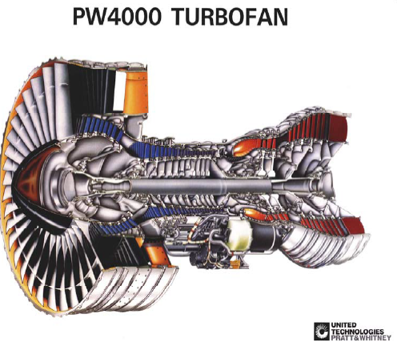
7.4 Gas Turbine Classifications & Configurations
High-bypass turbofan Engines (twin spool):

Slide 50
7.4 Gas Turbine Classifications & Configurations
High-bypass turbofan Engines (triple spool):

Slide 51
7.4 Gas Turbine Classifications & Configurations
Examples: Ramjet (J58 for SR71)
Notes:
“During engine start, rising fuel pressure in the fuel control signaled the ignition system that a metered amount of TEB could be injected into the engine combustion section, after the pilot moved the throttle from cut-off to the idle position. Preceded slightly by fuel, the TEB (triethylborane) exploded and ignited the JP-7.”

Slide 52
7.4 Gas Turbine Classifications & Configurations
Examples: Scramjet
Notes:
On 27 September 2021, DARPA announced successful flight of its Hypersonic Air-breathing Weapon Concept scramjet cruise missile.^{[30]} Another successful test was carried out in mid-March 2022 amid the Russian invasion of Ukraine. Details were kept secret to avoid escalating tension with Russia, only to be revealed by an unnamed Pentagon official in early April.^{[31][32]}

Slide 53
7.4 Gas Turbine Classifications & Configurations
Why so many different engines?
Notes:
Electric engines?

Slide 54
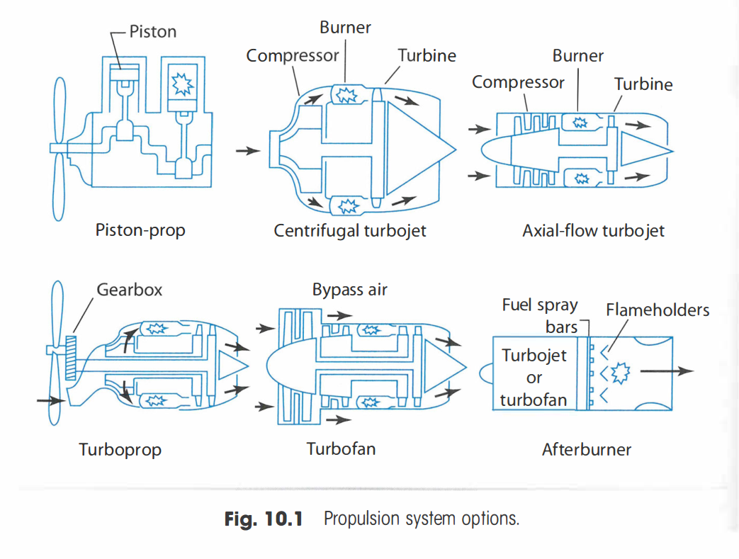
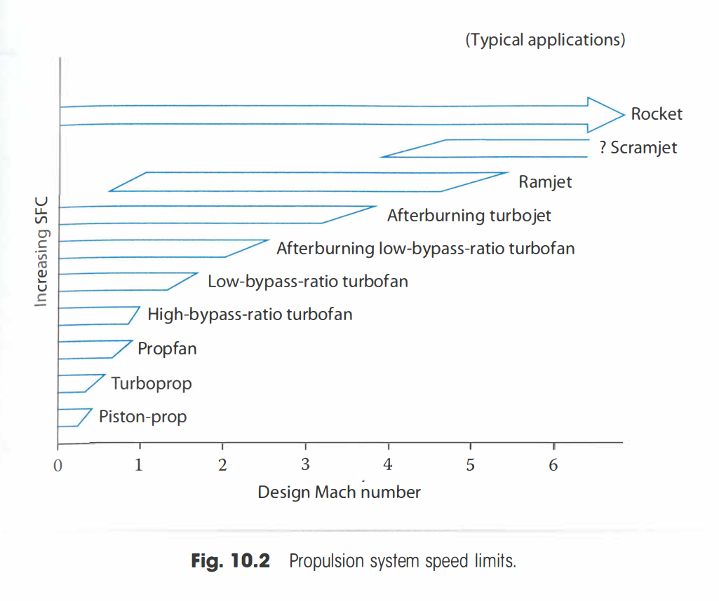
7.4 Gas Turbine Classifications & Configurations
Why so many different engines?

Slide 55
Lecture Contents
Preliminary Propulsion Sizing
7.1. Introduction
7.2. Gas Generators
7.3. Gas Turbine Thermodynamics (Recap)
7.3.1 Ideal Cycle
7.3.2 Gas Power & Efficiency
7.3.3 Real Processes
7.4. Gas Turbine Classifications & Configurations
7.5. Governing Equations of Gas Turbines
7.6. Engine Scaling techniques
7.6.1 Piston Engine Scaling
7.6.2 Propeller Engine Scaling
7.6.3 Turbojet Engine Scaling
7.6.4 Effects of Altitude and Velocity
7.7. Engine Manufacturers & Joint Programs
7.8. Future Developments
Notes:
Contents from this slide deck is sourced and adapted from Aircraft Design 1 Course. Content by Dr. Arvind. G. Rao and prof J.P. van Buijtenen from Delft, University of Technology

Slide 56
7.4 Gas Turbine Classifications & Configurations
Why so many different engines?

Slide 57
7.5 Governing Equations of Gas Turbines
Thrust parameters:
Gross thrust:
Net thrust:
Specific thrust:
Dimensionless metric of thrust: or
Notes:
C = speed
Non-dimensionalize as much as possible

Slide 58
7.5 Governing Equations of Gas Turbines
Fuel Consumption parameters:
Specific fuel consumption:
Dimensionless metric of thrust: or
Notes:
Sfc = ambient velocity / total efficiency * heat capacity
R specific gas constant

Slide 59
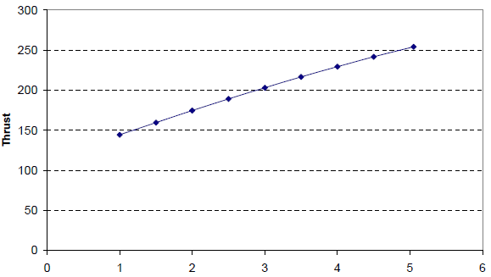
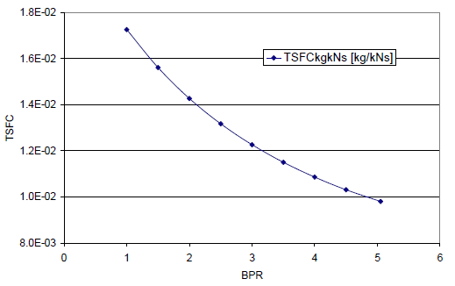
7.5 Governing Equations of Gas Turbines
Effect of bypass ratio on thrust and thrust specific fuel consumption (TSFC):
Net Thrust [kN]
Bypass Ratio [-]
Notes:
Trends with bypass ratio,

Slide 60
7.5 Governing Equations of Gas Turbines
Power-related parameters:
Propulsive jet power:
Thrust power:
Power loss

Slide 61
7.5 Governing Equations of Gas Turbines
(In-)efficiencies:
Chemical Energy
Heat
Gas Power
Kinetic Energy
Jet Power
Notes:
Lot of conversions of energy, these are all theoretical. Other forms (boundary drag) also exist.
1. Efficiency of the combustion 2. work done by gas generator / mass flow and change in temperature 3. power of the gas going out / work done by gas generator

Slide 62
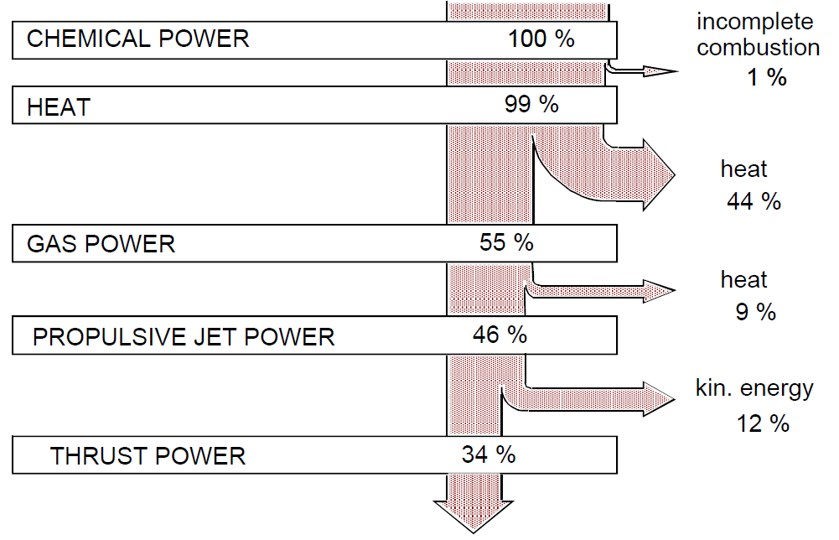
7.5 Governing Equations of Gas Turbines
(In-)efficiencies:
Jet Engine Power, Sankey diagram

Slide 63
7.5 Governing Equations of Gas Turbines
(In-)efficiencies:
With Losses
Ideal Processes
Notes:
Comparing with losses against ideal processes

Slide 64
7.5 Governing Equations of Gas Turbines
Variation of propulsive (In-)efficiencies:

Slide 65
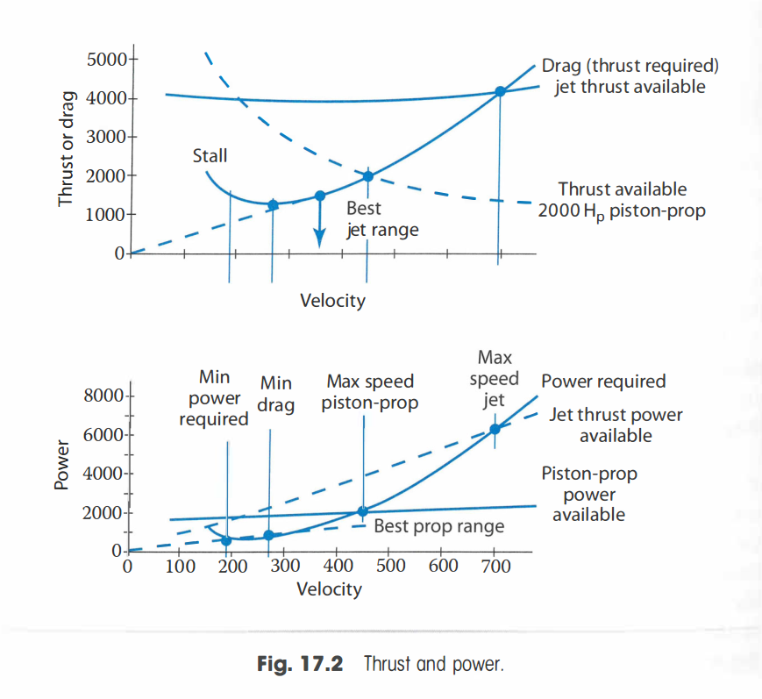
7.5 Governing Equations of Gas Turbines
During flight, the available power has to overcome the drag requirements:
Notes:
Min power required and min drag power.
What if power required if the velocity moves to zero?
In helicopters a certain power is required for hover

Slide 66
PRELIMINARY PROPULSION SIZING 1
AESP 415 – Aircraft Design Part I Basics
Lecture 9
MODULE
3
TOPIC 7
Thank You!
Dr. Wout De Backer
1000 Catawba St, Ste 120
wdbacker@cec.sc.edu

